Slide 1
Quadric and Cubic Equation

Slide 2


Quadric function

Slide 3




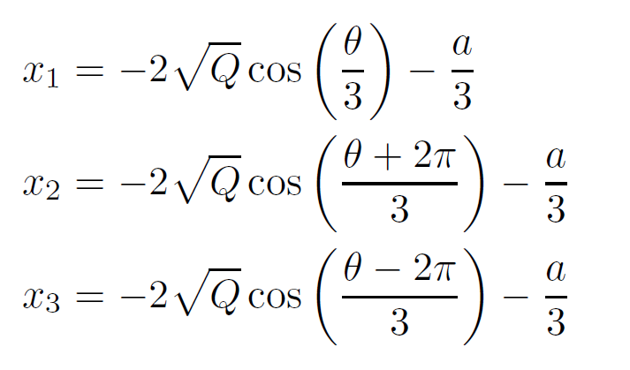
Cubic Equation

